Slide 1
Network management Communication model
Zeinab MOVAHEDI
Chapter 4 & 5
Network management principles and practices

Slide 2
Network Management Standards
Notes:
Network management standards:
OSI model
Internet model
TMN
IEEE LAN/WAN
Web-based model
Open System Interconnection (OSI) management standard:
Adopted by International Standards Organisation (ISO)
Protocol standard: Common Management Information Protocol (CMIP)
has built-in services => Common Management Information Services (CMIS): specify basic services needed to perform the various functions
Addresses all 7 layers of OSI reference model.
Object-oriented specification
Both LAN/WAN can be managed using CMIP/CMIS
Complex and large CMIP stack (memory of an ordinary workstation not capable to load a complet CMIP stack)
Simple Network Management Protocol (SNMP) standard:
Simple
Industry standard
Primarily intended to manage Internet, but now used to manage WAN and telecommunication systems.
Telecommunication Management Network (TMN):
Manage telecommunication network
Standard of International Telecommunication Union (ITU)
Based on CMIP/CMIS specifications
IEEE:
For WAN and MAN
OSI layer 1 and 2
Both CMIP/CMIS and Internet/SNMP use IEEE for lower layers
Easy to implement => most widely implemented network management system now

Slide 3
Network management - approches
Notes:
Organization
Network management components
Functions of components
Relationships
Defined in ISO 10040 system management overview
Specifies object, agent, manager terms
Information
Structure of management information (SMI)
Syntax and semantics
Management information base (MIB)
Organization of management information
Object-oriented
Communication
Mgmt. application processes, layer Mgmt.
between layers, layer operation within layers
Transfer syntax with bi-directional messages
Transfer structure (PDU)
Functions
User oriented requirements of network management
Application functions (FCAPS)
Configure components
Monitor components
Measure performance
Secure information
Usage accounting
Organization
Same as OSI model
Information
Same as OSI, but scalar
Communication
Messages less complex than OSI and unidirectional
Transfer structure (PDU)
Functions
Application functions
Operations
Administration
Security

Slide 4
Managed LAN
172.17.252.110
172.16.252.1

Slide 5
Managed hub: system information

Slide 6
Managed router: system information

Slide 7
Internet SNMP management
1970 Internet control Message Protocol (ICMP) developped to manage Advanced Research Project Agency Network (ARPANET)
Packet Internet Groper (PING)
1980 advent of Unix & client-server architecture
ARPANET developed into the inter-networking
ARPANET → Internet
1984 Internet Advisory Board (IAB) formed to administor Internet activities
Growth in the Internet, remote monitoring and configuration required
Simple Gateway Monitoring Protocol (SGMP)
Simple Network Management Protocol (SNMP)
Interim solution → de facto standard
Extensive implementation
Enormous simplicity
SNMPv2
SNMPv3

Slide 8
SNMP model
Organization Model
Relationship between network element, agent, and manager
Hierarchical architecture
Information Model
Uses ASN.1 syntax
SMI (Structure of Management Information
MIB ( Management Information Base)
Communication Model
Transfer syntax
SNMP over TCP/IP
Communication services addressed by messages
Security framework community-based model

Slide 9
Two-tier organisation model

Slide 10
Three-tier organisation model: RMON

Slide 11
Three-tier organisation model: Proxy server

Slide 12
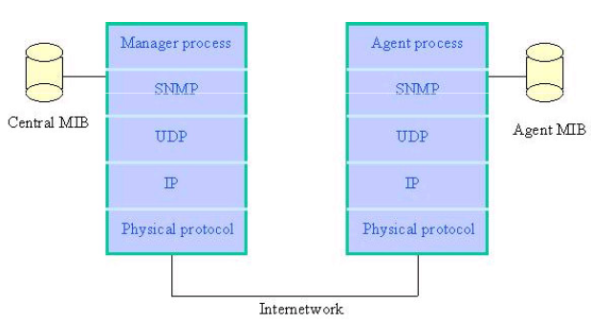
SNMP architecture

Slide 13
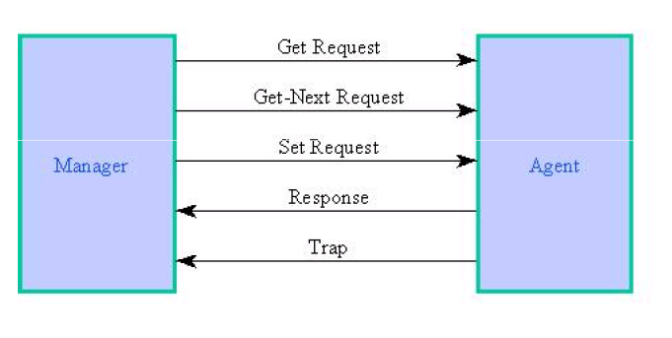
System architecture

Slide 14
SNMP messages
Get-Request
Sent by manager requesting data from agent
Get-Next-Request
Sent by manager requesting data on the next MO to the one specified
Set-Request
Initializes or changes the value of network element
Get-Response
Agent responds with data for get and set requests from the manager
Trap
Alarm generated by an agent

Slide 15
SNMP community

Slide 16
Community profile

Slide 17
Generalized administration model

Slide 18
SNMP protocol specifications
Protocol entities : peer processes implementing SNMP & supporting SNMP application entities
Communication among protocol entities using messages encapsulated in UDP datagrams

Slide 19
SNMP protocol specifications
SNMP protocol entities received on
port 162 for traps
Port 161 for other messages
Maximum length of the protocol on SNMPv1 is 484
The implementtaion of all five PDUs are mandatory
GetRequest-PDU, GetNextRequest-PDU, GetResponse-PDU, SetRequest-PDU and Trap-PDU
RFC 1157

Slide 20
RFC 1157 - SNMP
RFC1157-SNMP DEFINITIONS :: BEGIN
IMPORTS
ObjectName, ObjectSyntax, NetworkAddress, IpAddress, TimeTicks FROM RFC1155-SMI
Message ::= SEQUENCE {
version
INTEGER {
version-1(0)
},
community OCTET STRING,
data ANY
}

Slide 21
RFC 1157 - SNMP
-- PDUs
GetRequest-PDU ::= [0] IMPLICIT PDU
GetNextRequest-PDU ::= [1] IMPLICIT PDU
GetResponse-PDU ::= [2] IMPLICIT PDU
SetRequest-PDU ::= [3] IMPLICIT PDU

Slide 22

get & set PDUs
PDU ::= SEQUENCE {
request-id INTEGER,
error-status INTEGER {
noError(0),
tooBig(1),
noSuchName(2),
badValue(3),
readOnly(4),
genErr(5)},
error-index INTEGER,
variable-bindings VarBindList
$$\}$$

Slide 23
Trap PDU

Slide 24
Trap PDU
Trap-PDU ::= [4] IMPLICIT SEQUENCE {
enterprise OBJECT IDENTIFIER,
agent-addr NetworkAddress,
generic-trap INTEGER {
coldStart(0),
warmStart(1),
linkDown(2),
linkUp(3),
authenticationFailure(4),
egpNeighborLoss(5),
enterpriseSpecific(6)},
specific-trap INTEGER,
time-stamp TimeTicks,
variable-bindings VarBindList
}
VarBind ::= SEQUENCE {
name ObjectName,
value ObjectSyntax
}
VarBindList ::= SEQUENCE OF VarBind
END

Slide 25
Get Request – System group

Slide 26
IP address table

Slide 27
Tabular Representation of Aggregate Object

Slide 28
Object identifier of aggregate objects

Slide 29
Multiple Instances of Aggregate Managed Object

Slide 30
Chapter 5
MIB for Get-Next-Request
Notes
Network Management: Principles and Practice
© Mani Subramanian 2000
5-16

Slide 31
Chapter 5
Lexicographic Order
Network Management: Principles and Practice
© Mani Subramanian 2000
5-17

Slide 32
Chapter 5
MIB Lexicographic Order
Notes
A 3.1
B 3.2
T Z
E
1.1
1.2
2.1
2.2
Network Management: Principles and Practice
© Mani Subramanian 2000
5-18

Slide 33
Chapter 5
A More Complex MIB Example
Notes
Network Management: Principles and Practice
© Mani Subramanian 2000
5-19

Slide 34
Get-Next-Request operation

Slide 35
Get-Next-Request operation

Slide 36
SNMP MIB

